Slide 1
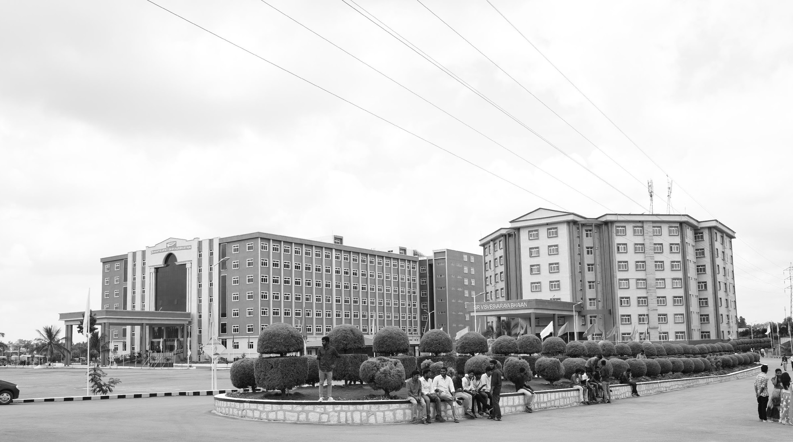

Review-I
5G NEW RADIO PHYSICAL LAYER SIMULATION
AY 2025-26
Capstone Project – Introduction (PROJ2999)
GITAM (Deemed-to-be) University
Department of Electrical Electronics and Communication Engineering
Project Team:
C. Lakshmi Narayana
P. Hemanth
P. Hari Krishna
Project Mentor:
Dr. T. Nagarjuna
Project In-charge:
Dr. Kshitij Shakya
www.gitam.edu

Slide 2
Objective and Goals
Objective
The primary objective is to design and implement a 5G New Radio physical layer simulation.
To evaluate system performance under various channel conditions and validate the efficiency of signal processing algorithms before hardware implementation.
Goals
To build a complete end-to-end 5G physical layer simulator in MATLAB.
To analyze and visualize key performance metrics such as Bit Error Rate (BER) and throughput.

Slide 3
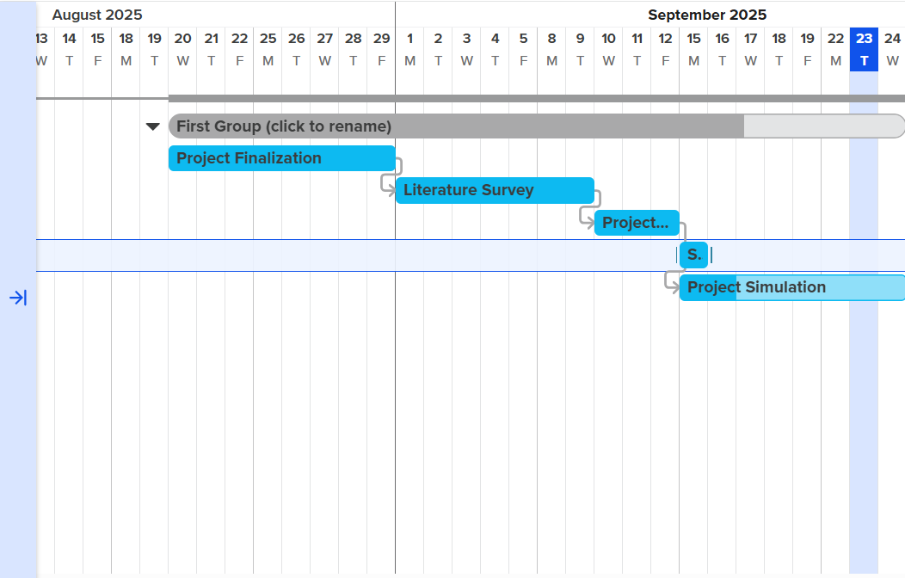
Project Plan (Clearly mention milestone for objectives under each reviews)
Gant Chart - Milestones and Activities

Slide 4
Project Plan (Clearly mention milestone for objectives under each reviews)
Gant Chart – Milestones and Achievements

Slide 5
Literature Survey
Key Publications :
Author details | Research contributions | Research Limiations
Morais, D. H. (2024). 5G NR overview and physical layer. In Key 5g/5g-advanced physical layer technologies: Enabling mobile and fixed wireless access (pp. 233-321). Cham: Springer International Publishing. | Provides a structured overview of 5G NR physical layer functions (channels, signals, scheduling, HARQ, power control) and their role in achieving high data rates and low latency. Highlights the evolution of 5G through Releases 15–19, offering insights into both current capabilities and future enhancements. | Focuses on high-level architecture and procedures without detailed technical algorithms or performance analysis. Relies mainly on 3GPP specifications, with limited discussion of real-world deployment challenges or empirical validation.
Ssimbwa, J., Yoon, S. H., Lee, Y., & Ko, Y. C. (2024). Towards 5G-advanced NR-unlicensed systems: Physical layer design and performance. Journal of Communications and Networks, 26(2), 207-214. | It provides a detailed performance analysis of specific NR-U scheduling configurations, highlighting the trade-offs of frame structure, HARQ, and RLC parameters. It presents quantitative evidence through simulation that demonstrates the direct performance impact of the chosen NR-U design configurations. | The findings are exclusively based on simulations and have not been validated in a real-world hardware or network environment. The research scope is limited to a select subset of parameters, omitting other critical factors like mobility and dynamic interference.

Slide 6
Author details | Research contributions | Research Limitations
Rossato, F. (2024). Simulation Study, Design and Implementation of 5G NR Layer-2 Protocols for Non-Terrestrial Networks. | Developed new 5G NR Layer-2 protocols (HARQ and scheduling) for NTNs, improving reliability and throughput. Enhanced the ns-3 NTN module to handle high propagation delays and reduce unnecessary retransmissions. | Tested only through simulations, not on real NTN hardware or testbeds. Other protocol stack challenges in NTNs (handover, synchronization) were not addressed.
Belesaca, J. D., Vazquez-Rodas, A., Urquiza-Aguiar, L. F., & Vega-Sánchez, J. D. (2024). An in-depth assessment of the physical layer performance in the proposed B5G framework. Ad Hoc Networks, 164, 103609. | It provides a comparative performance analysis of the 5G using ideal, practical, and novel CNN-based channel estimation techniques. It identifies the specific physical layer elements that most significantly impact system performance, guiding future B5G optimization strategies. | The conclusions are derived entirely from simulations and lack validation from real-world hardware or live network deployments. The analysis is focused exclusively on the downlink (PDSCH) and does not evaluate the performance of the uplink channel.

Slide 7
Key Publications
Key Resources – Whitepaper| Application Notes | Datasheet| Others
https://devopedia.org/5g-nr-phy
Existing Implementations – Products| Opensource| GitHub etc
GitHub : https://github.com/kir812/pyPhyNR

Slide 8
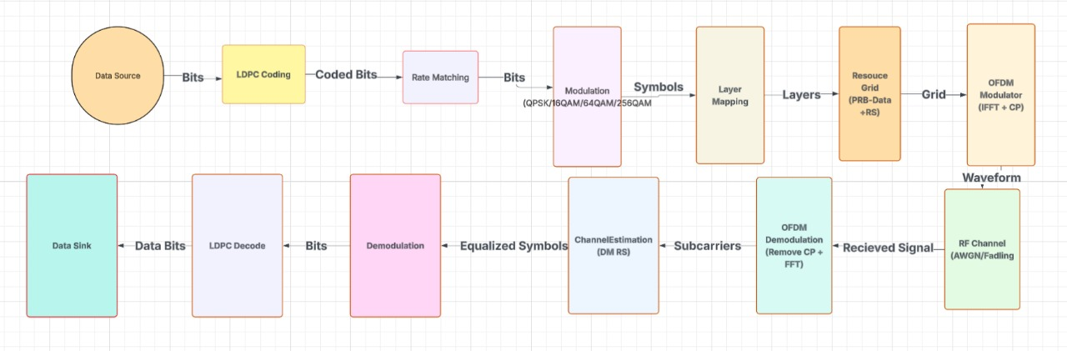
5G Architecture

Slide 9
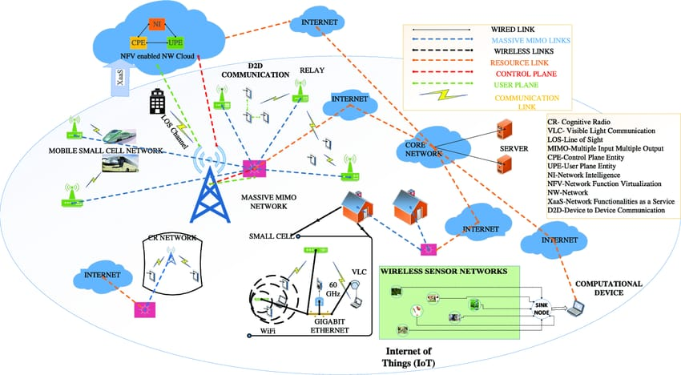
5G Architecture Applications

Slide 10
THANK YOU
Have a Great Day !

